Slide 1
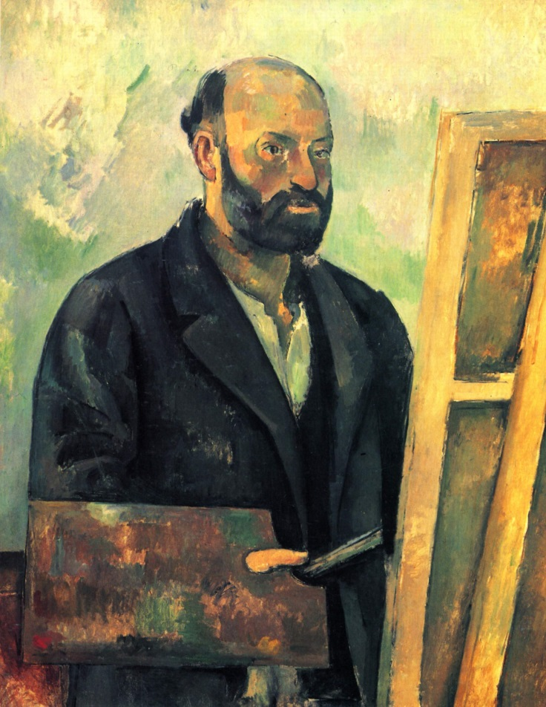
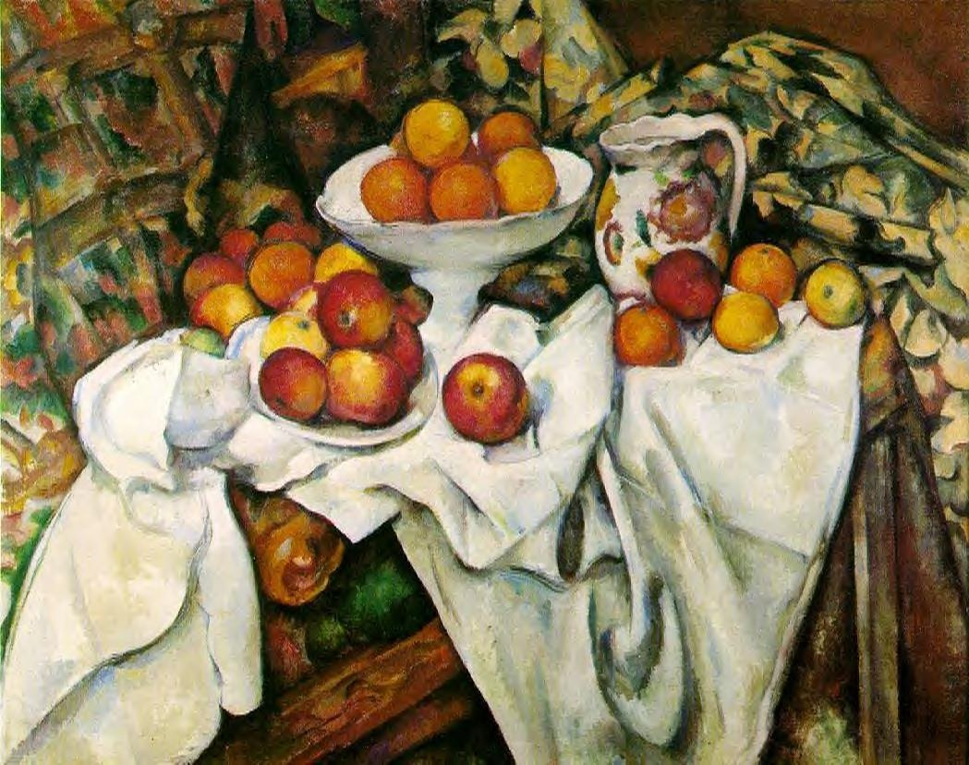
Paul Cézanne
K to 2nd grade
and still life

Slide 2
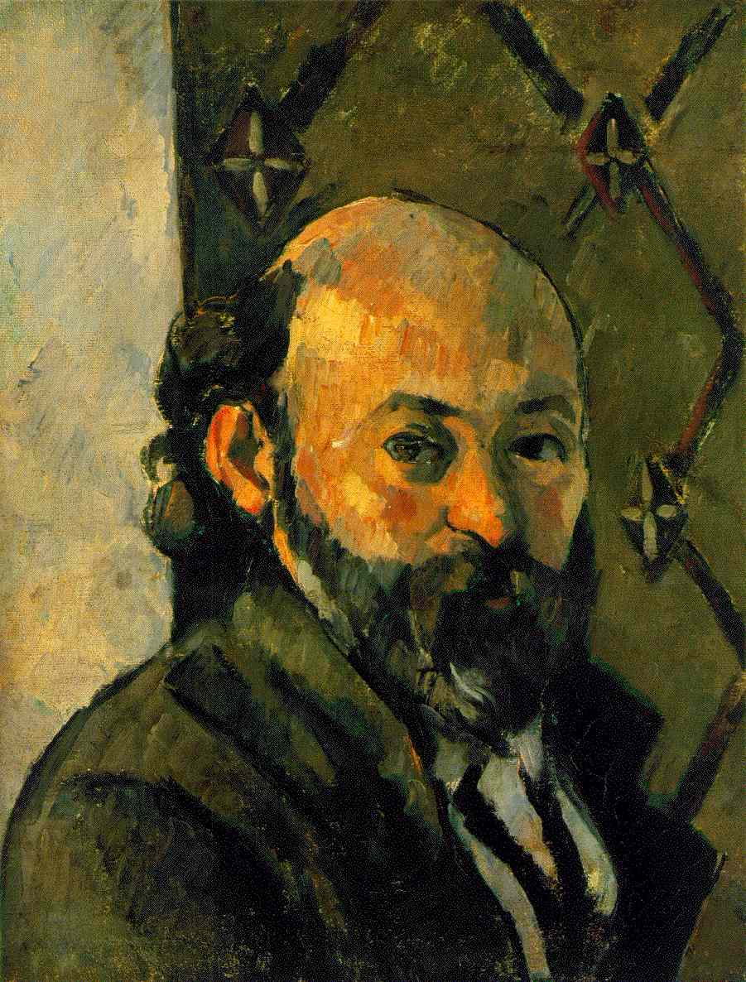
Paul Cézanne
Paul believed that
color, light and space
were the most important elements of any art.
He believed it was enough to make any art unique!

Slide 3
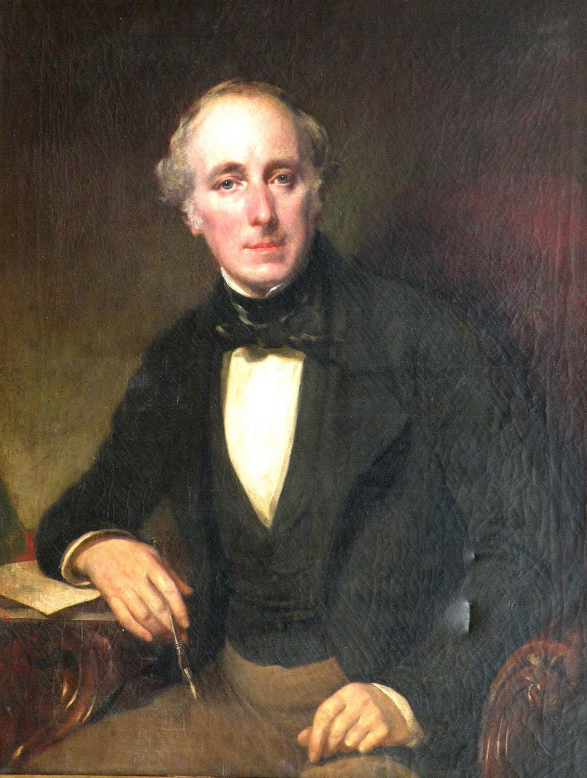
So, while other artists painted
portraits of rich people

Slide 4
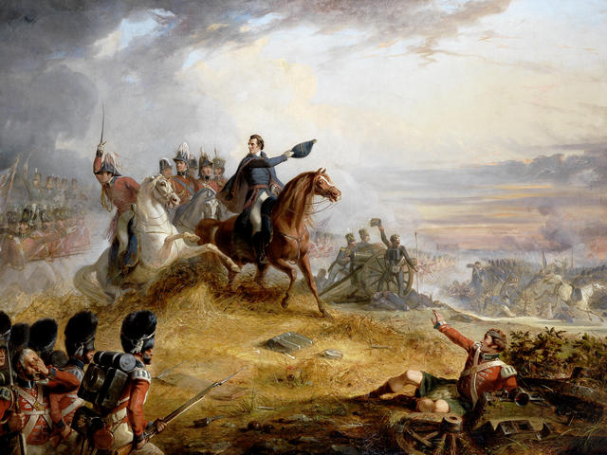
Epic battle scenes

Slide 5
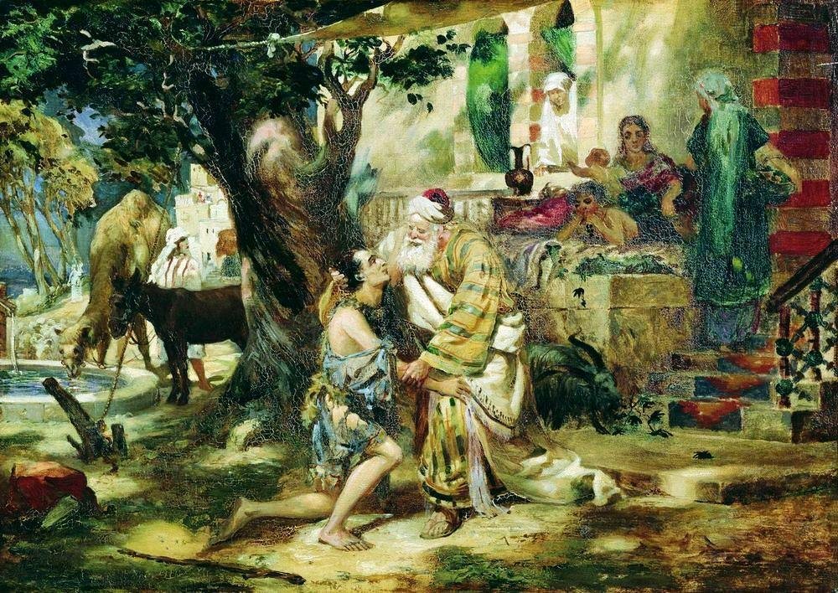
or religious and mythical scenes

Slide 6
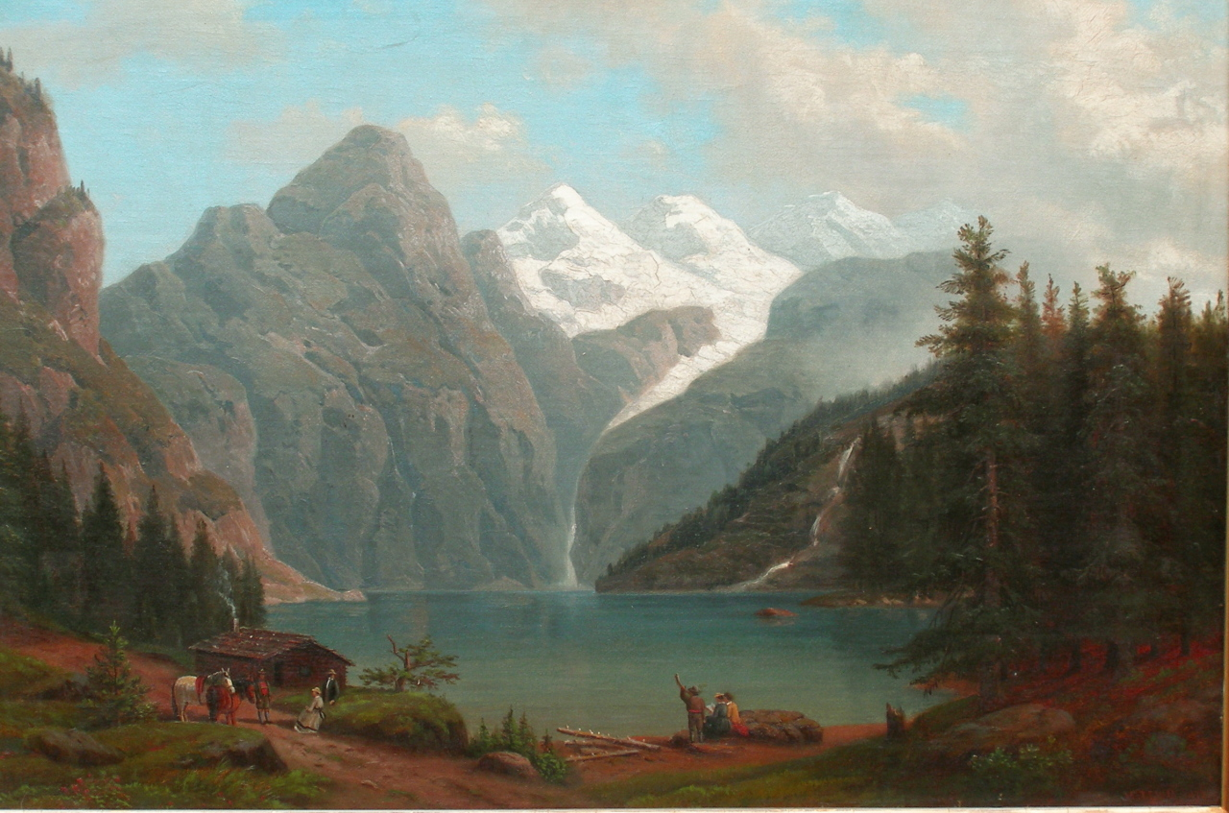
and landscape artists were considered slackers by most critics...

Slide 7
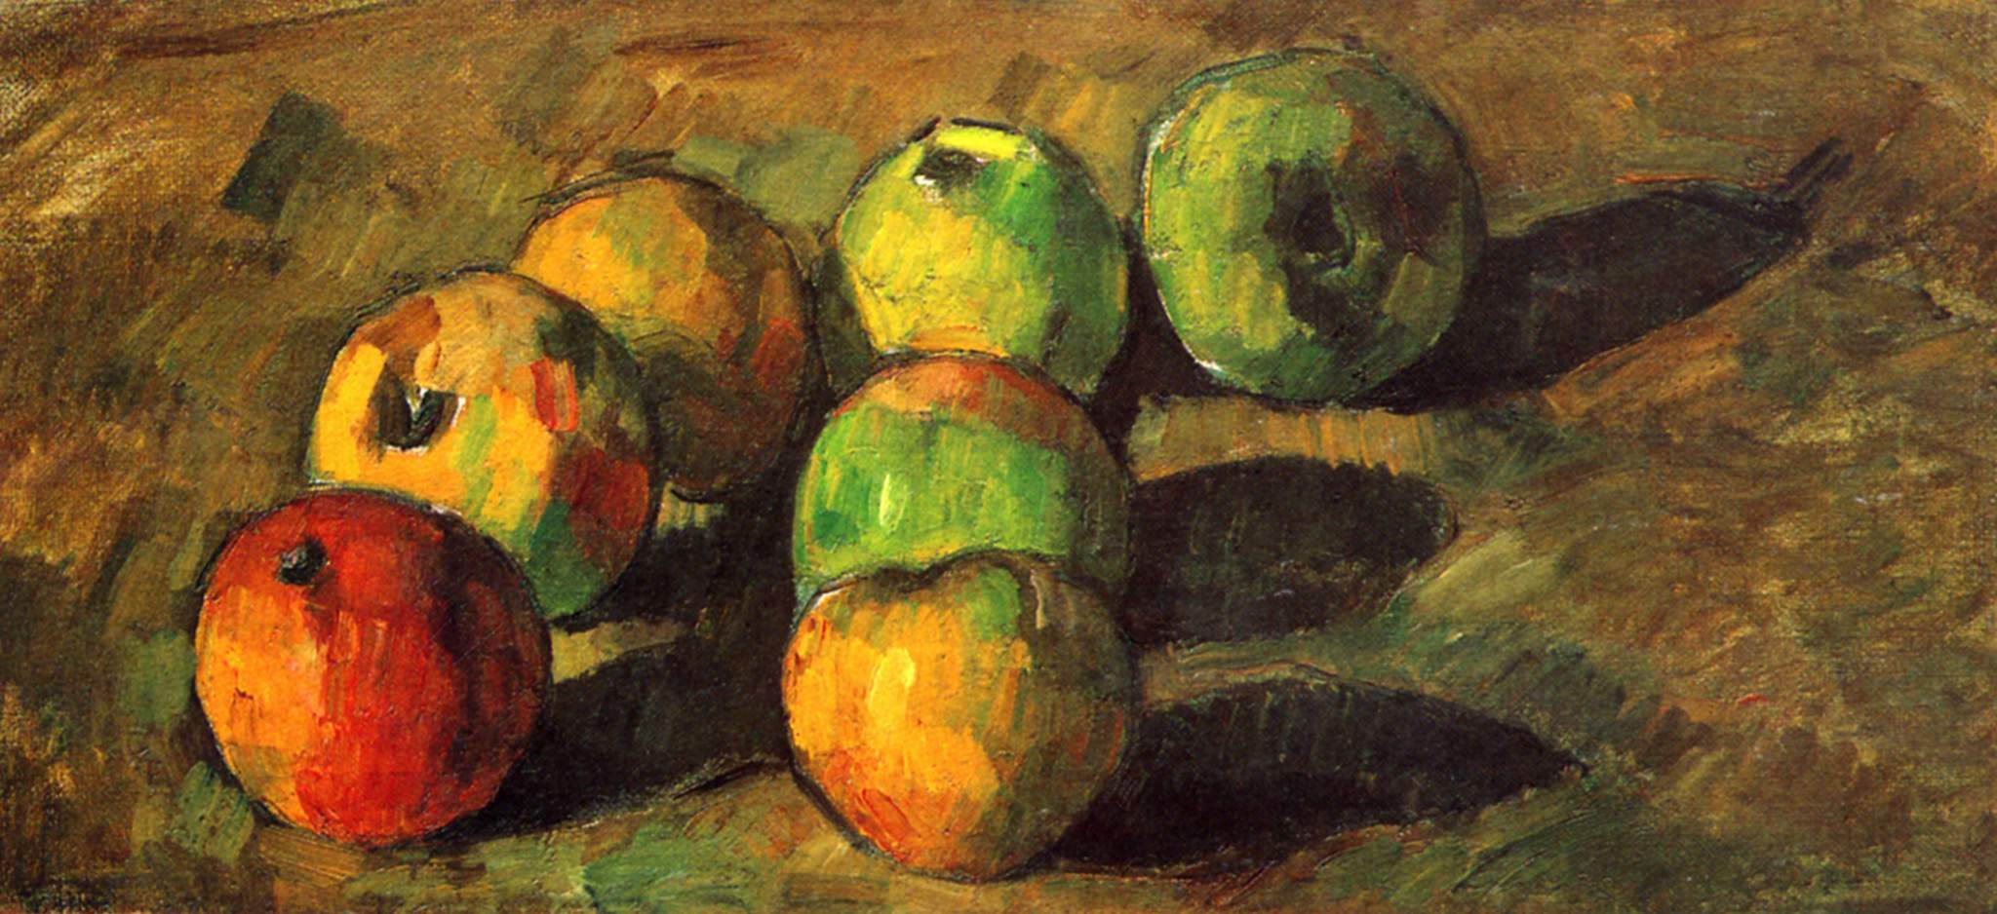
Paul decided to paint only the lowliest art form of them all:
still life!

Slide 8
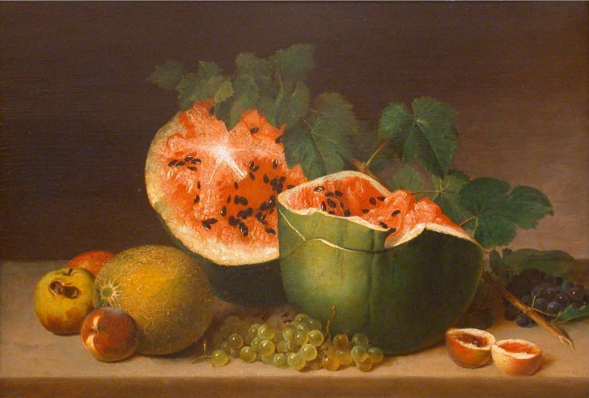
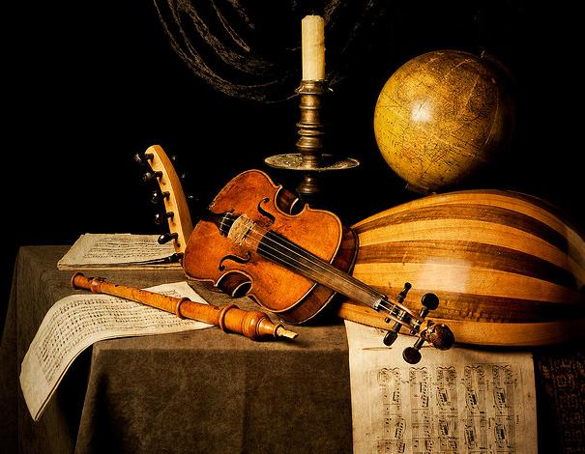
What is a still life painting?
A still life is a work of art capturing mostly inanimate objects.
They are painting of:
Food
Flowers
Plants
Rocks or shells
Drinking glasses
Books
Vases
Jewelry
What else could you paint?

Slide 9
Paul painted still lifes but to prove his point: that art can be anything if you do it right,
he decided to painted the most common thing he could fine:
an APPLE

Slide 10
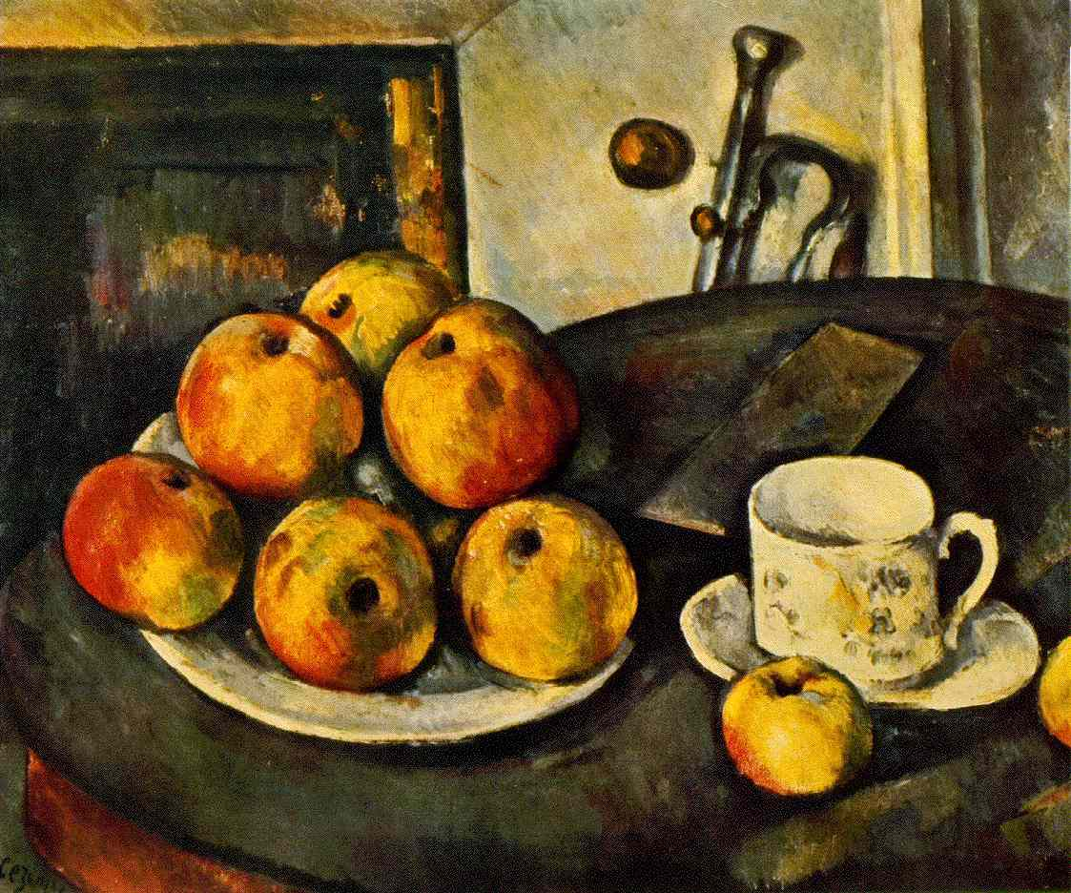
He said: I want to astonish Paris with an apple!
And after more than 30 years of hard work, he did!

Slide 11
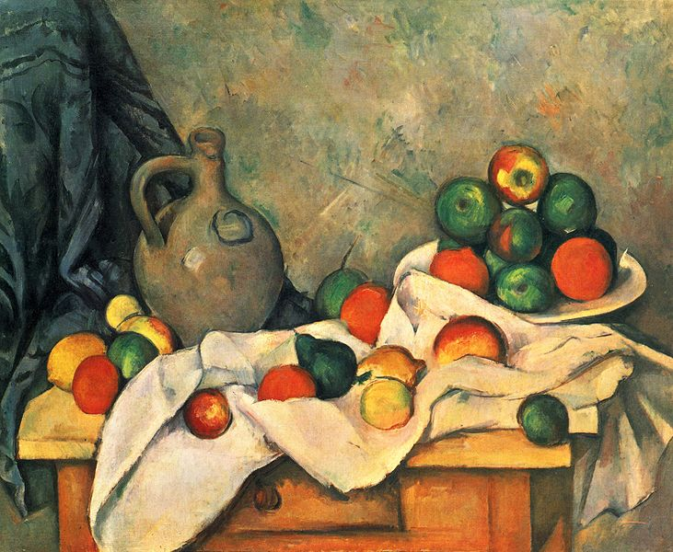
How did he do that?
He played around with colors, light and space
(like nobody before him)
He had a lot of fun especially with space… let’s see it!
Still Life, Drapery, Pitcher, and Fruit Bowl, 1893-4

Slide 12
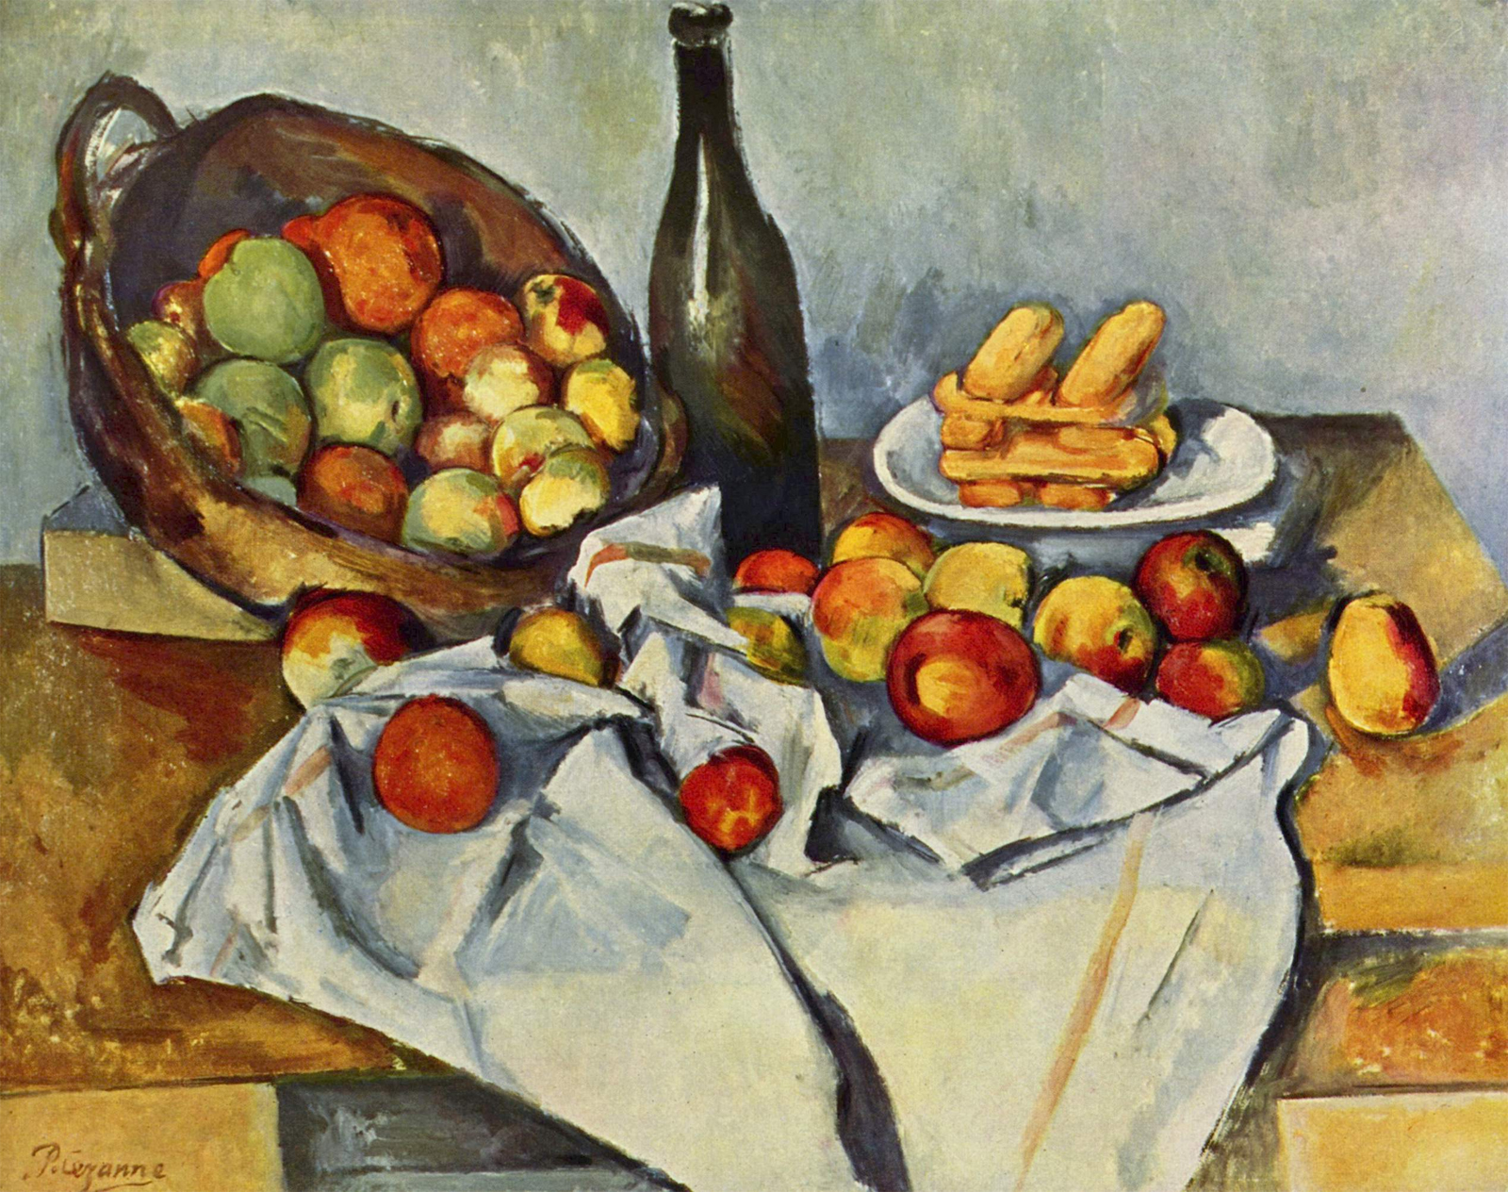
The Basket of Apples, 1890-4
Do you see anything WEIRD, anything that DOES NOT MAKE SENSE in this painting?

Slide 13
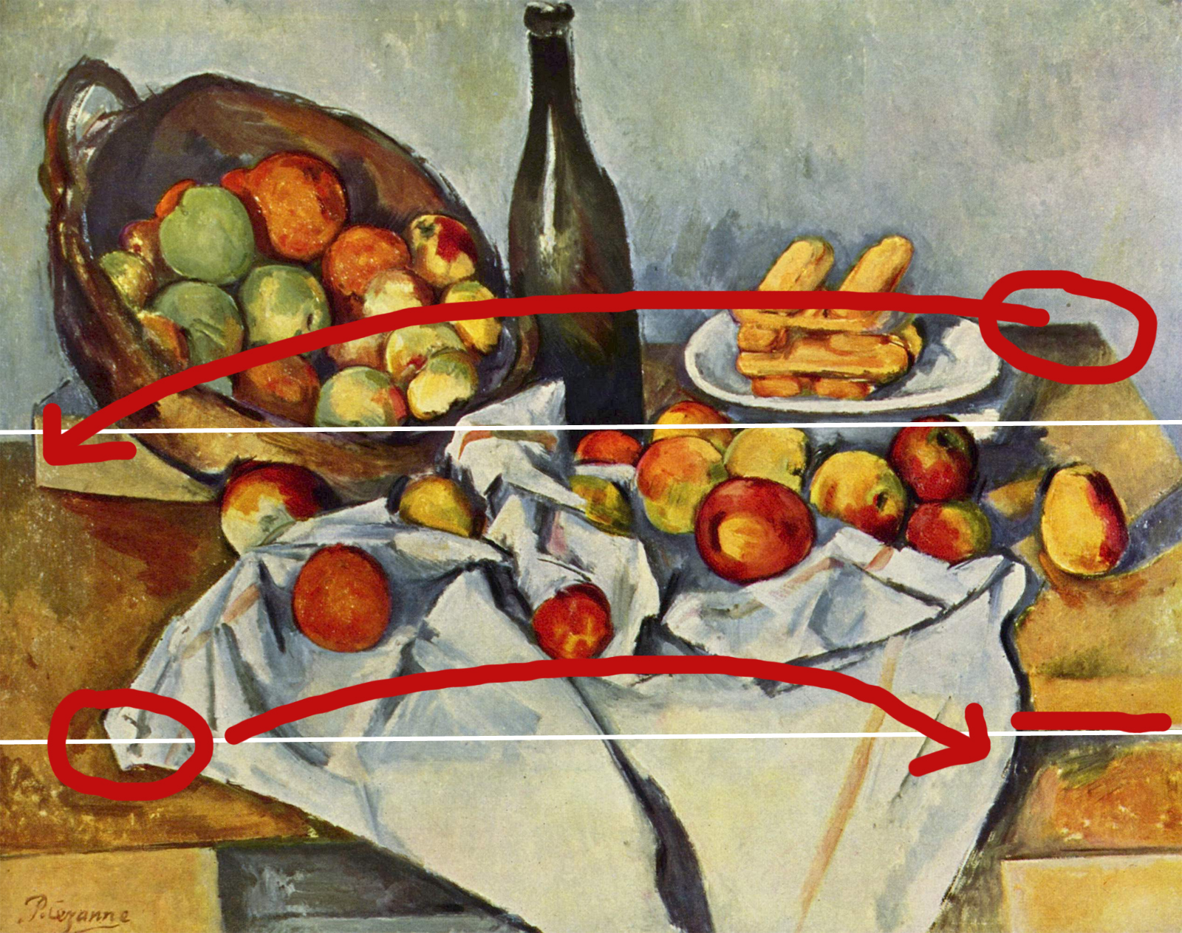
The table ends in different places.
It looks like Paul looked at it from two different places and combined it together.

Slide 14
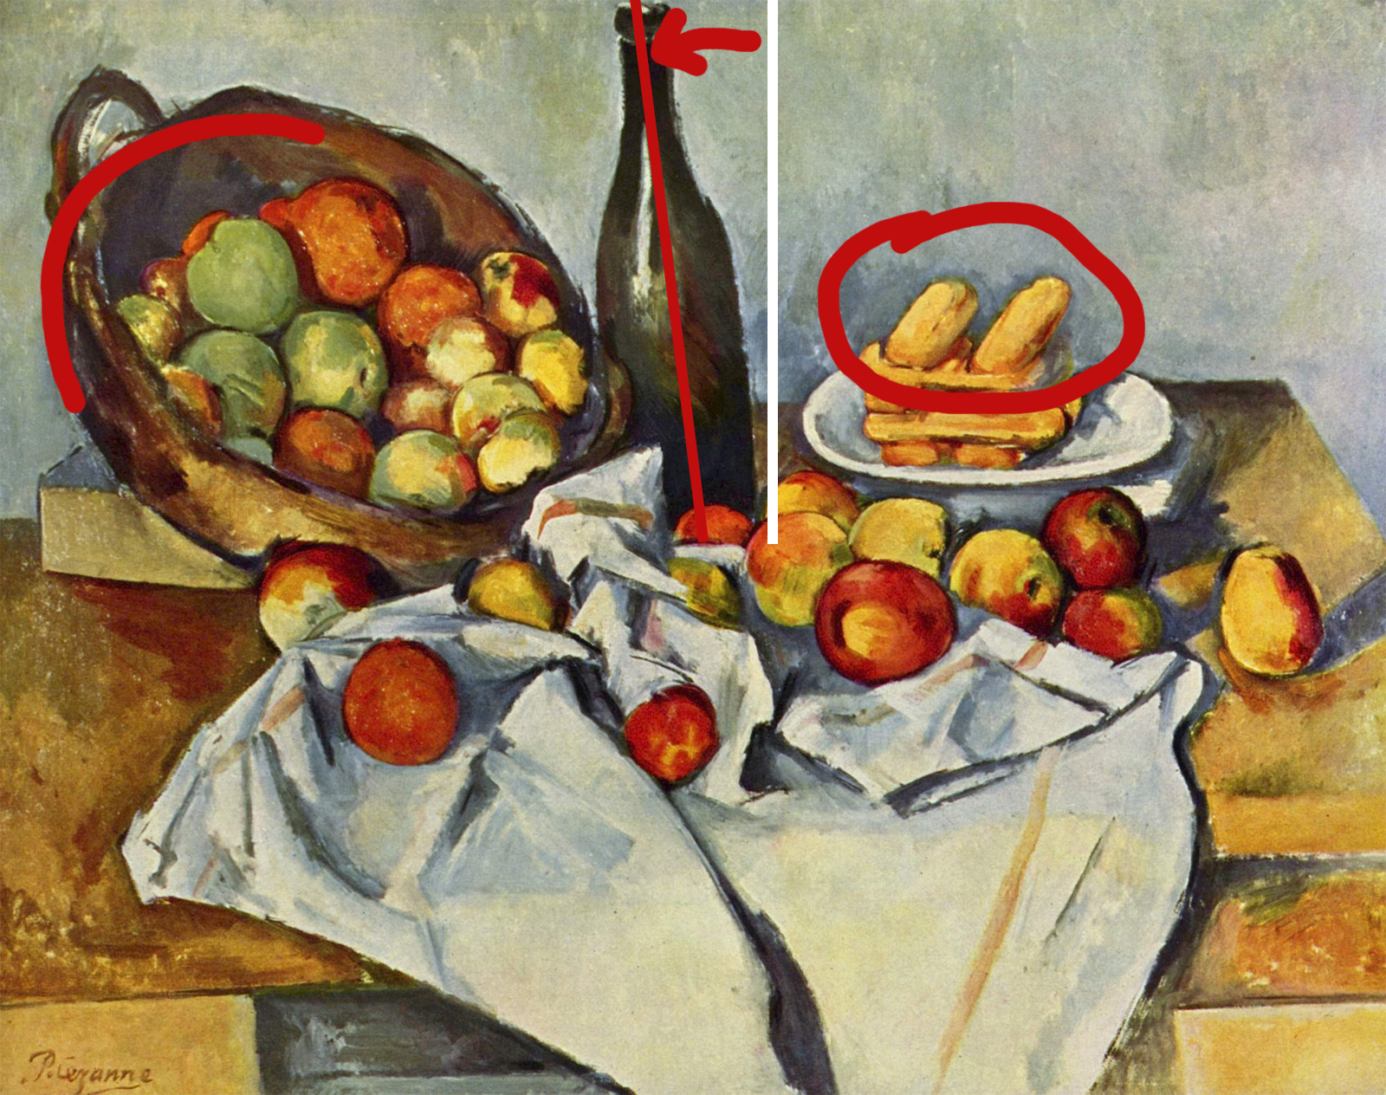
The bottle is tilted. The basket would fall. Biscuits fly!

Slide 15
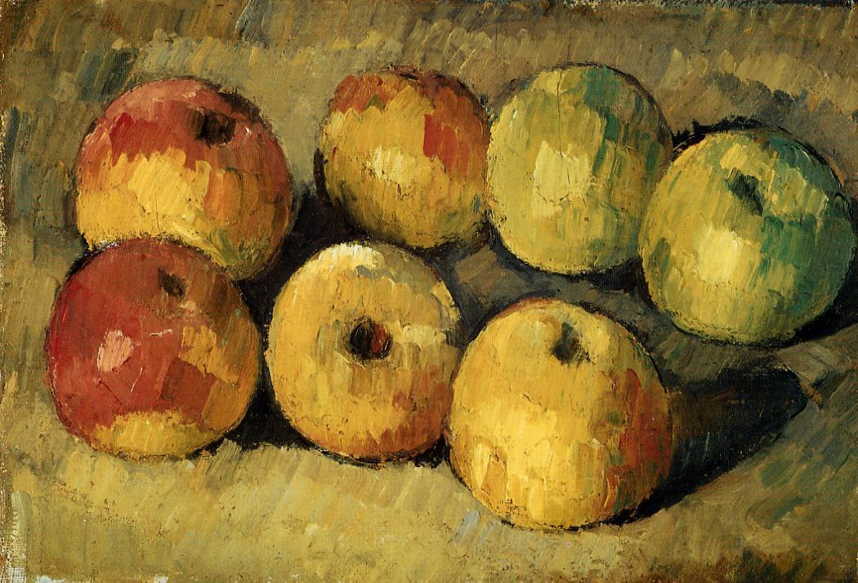
Paul painted over 200 still life paintings with apples.
Apples, 1878

Slide 16
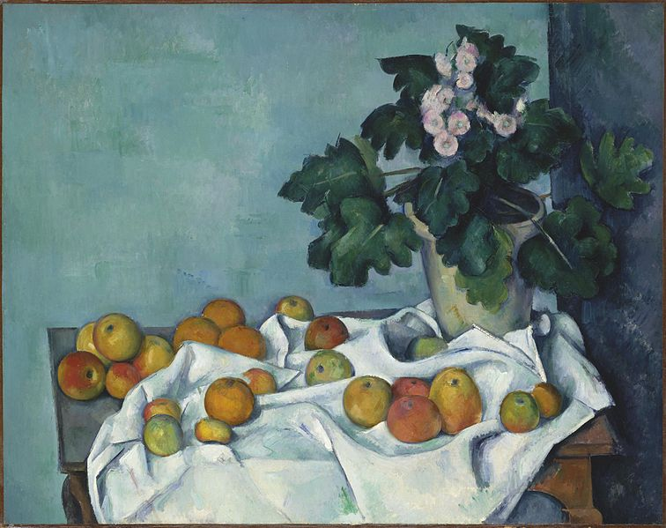
Still Life with Apples
and a Pot of Primroses
1890
He carefully set the scene – with fat coins and small wedges stuck underneath
the apples to tilt them and lift them up.

Slide 17
Still Life, Drapery,
Pitcher, and Fruit Bowl
1893-4
He looked at it from different angles – and used many of them in one artwork.
That is why the paintings trick the eye and keep it moving around, looking for the other edge of the table.

Slide 18
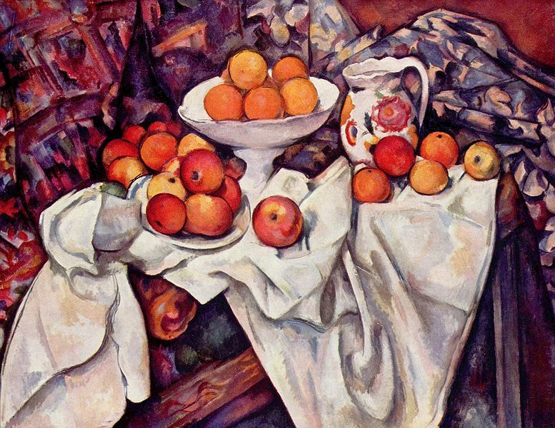
Then he painted the scene. Slowly. For many days.
And yes, often he needed to get new apples.
They got bad – or eaten (if he was hungry).
Apples and Oranges, 1899

Slide 19

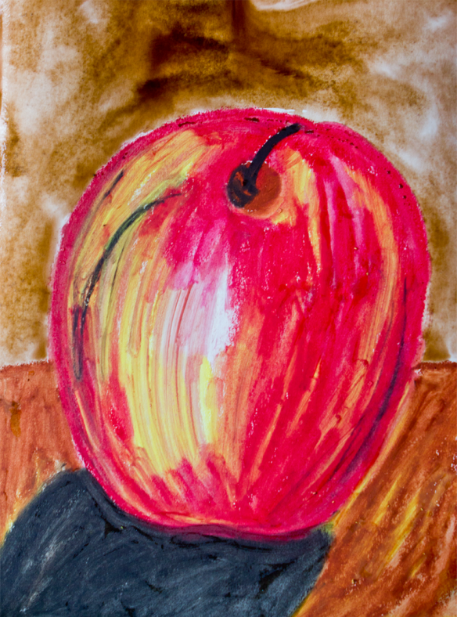
Let’s make some ART!

Slide 20
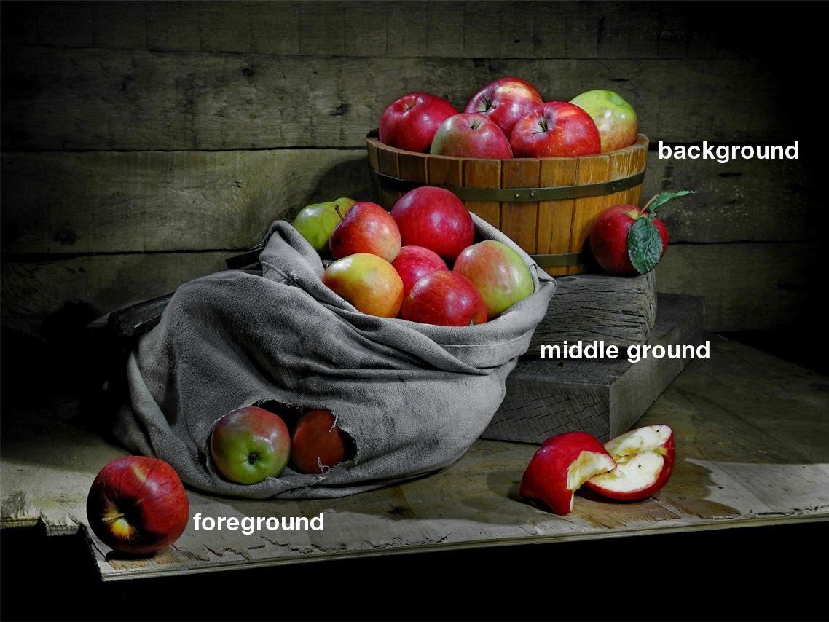
Fist create your still life
What is a composition?
It is the placement of objects in a painting.
It literally means: putting together.

Slide 21
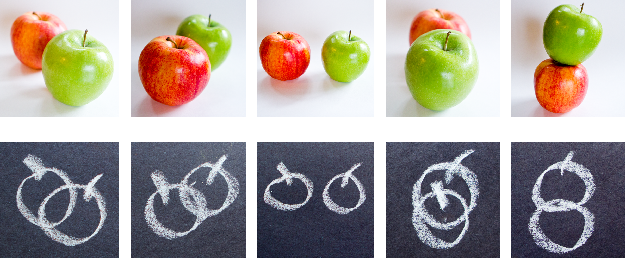
How do you draw this?
Which apple is in the foreground?
Which one is in the background?
Look at your still life. What is in the foreground?
Remember, everybody at your table can see it differently, depending on where they sit.

Slide 22
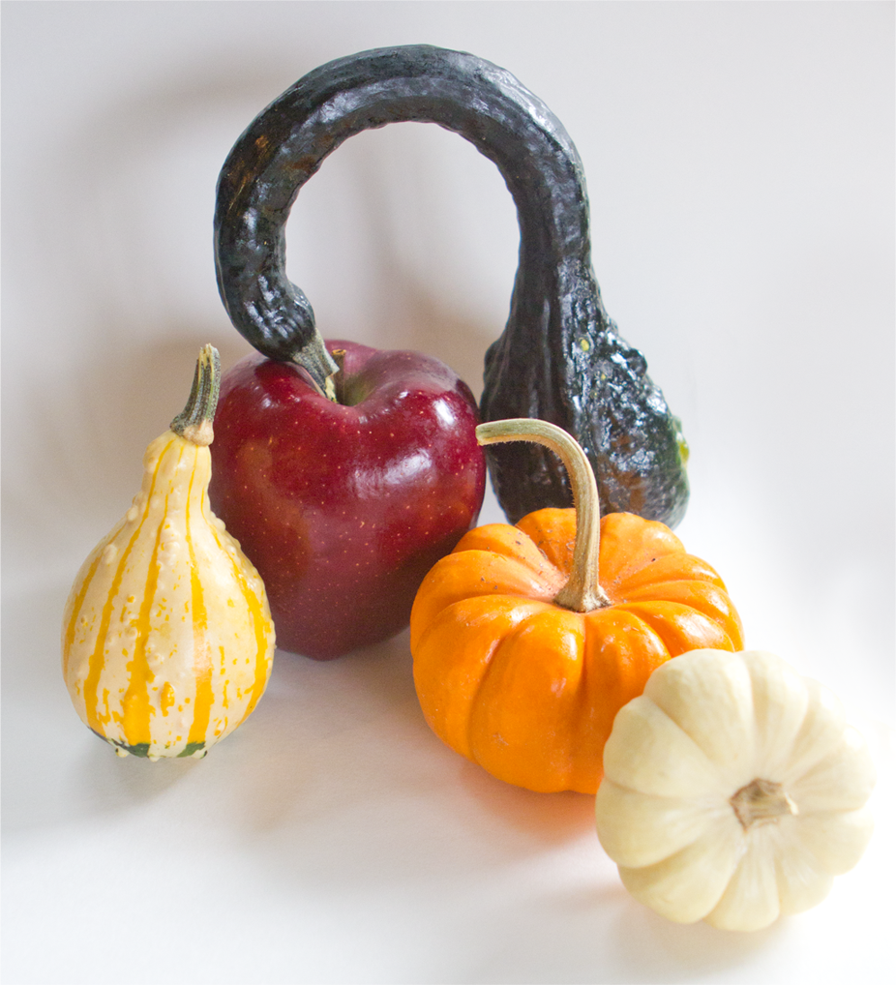
How does your still life look like?
What is in the foreground?
In the middle ground?
In the background?

Slide 23
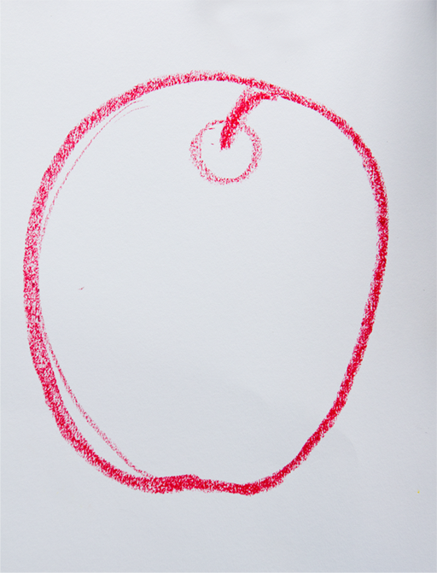

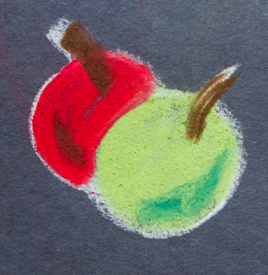
Sketch what you see!
But do not be afraid to exaggerate a little, like Paul.
Sketch it with oil pastels.
You can sketch the apple like this:
because we will color it in
and you will not see the lines.

Slide 24
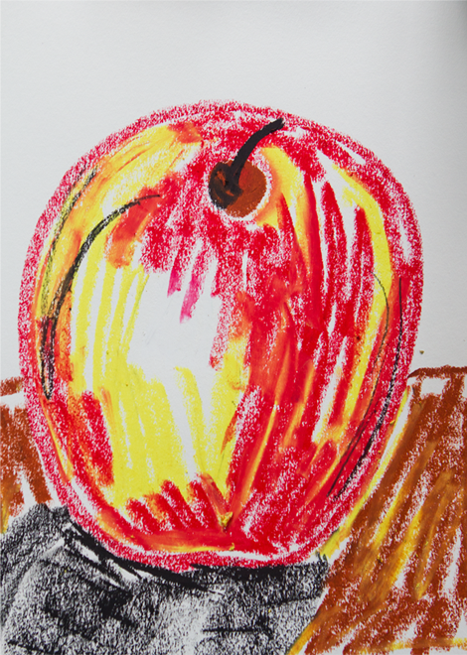
Color it in
What colors do you see?
Color it in.
It does not have to be perfect.
In should not be perfect.
You are done when it looks like this.

Slide 25
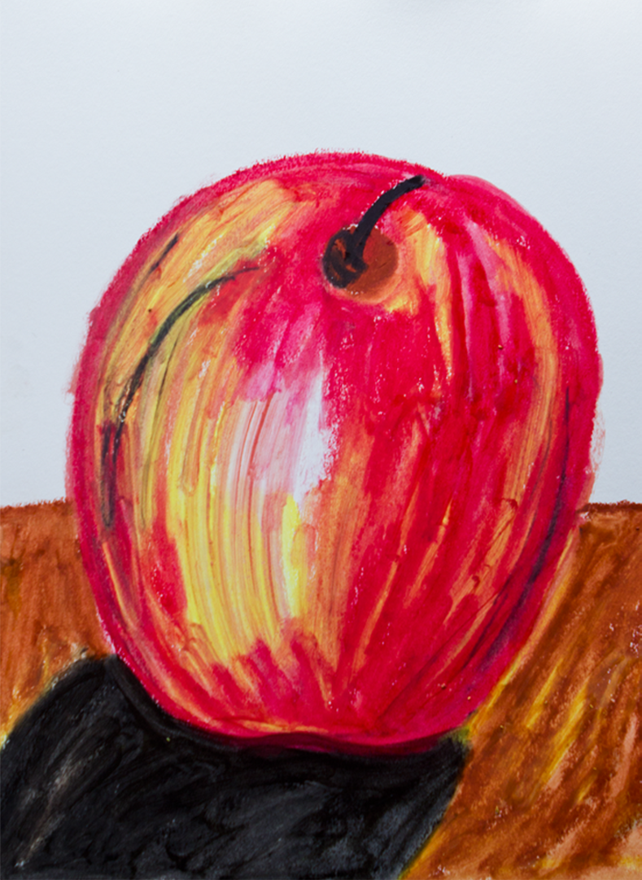

Blend it (with oil)
Dip your q-tips in oil.
DO NOT SPILL
Blend (mix) the colors together with oil.
Do you see what happens?

Slide 26

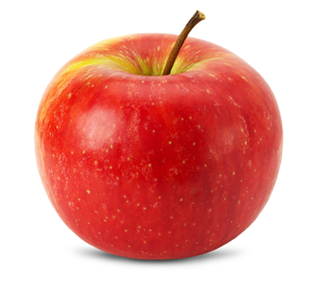
Watercolor background
Use watercolors to paint over
the background.
You can go over the still life,
it will not stick on the oil pastels.

