Slide 1
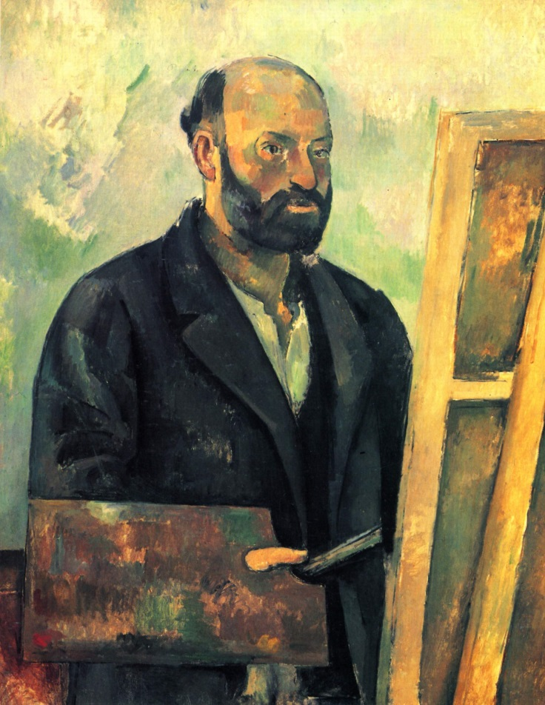
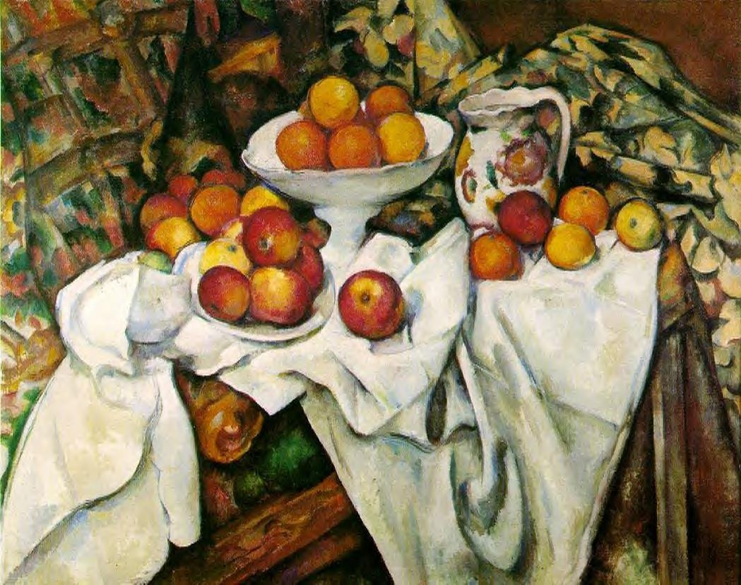
Paul Cézanne
3 to 5th grade
and still life

Slide 2
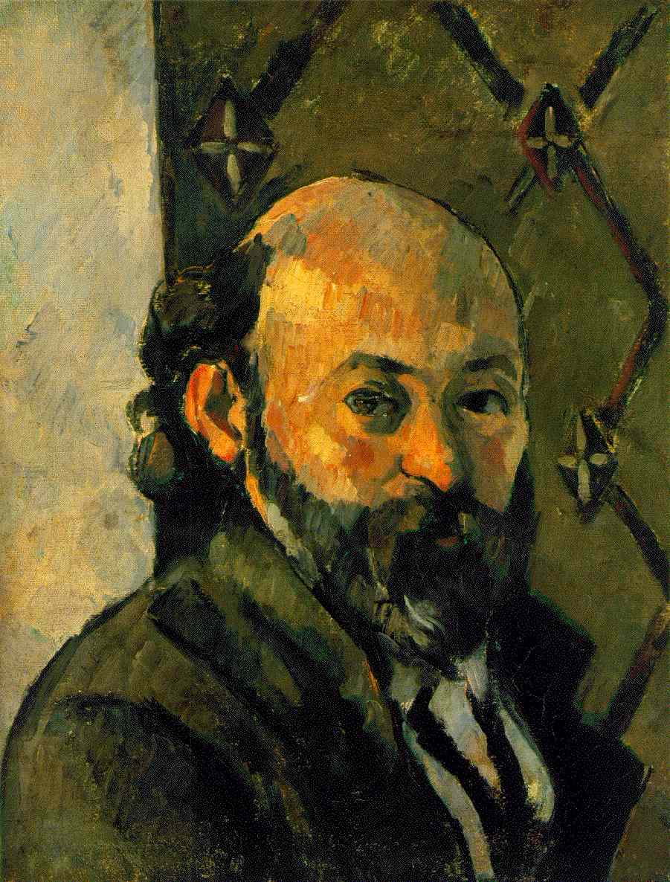
Paul Cézanne
Paul believed that
color, light and space
were the most important elements of any art.
He believed it was enough to make any art unique!

Slide 3
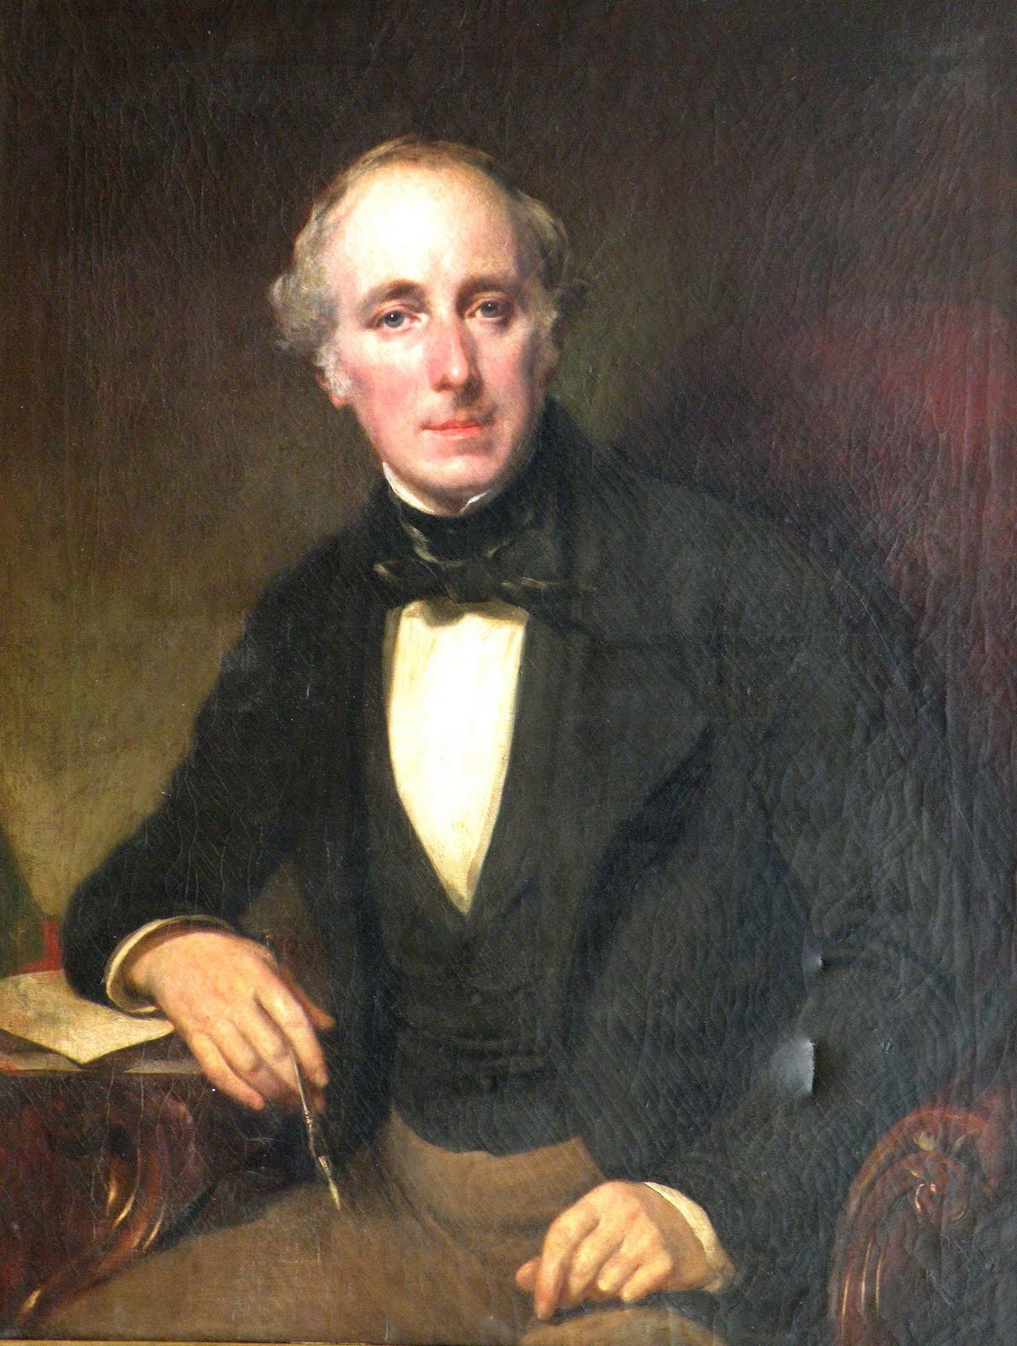
So, while other artists painted
portraits of rich people

Slide 4
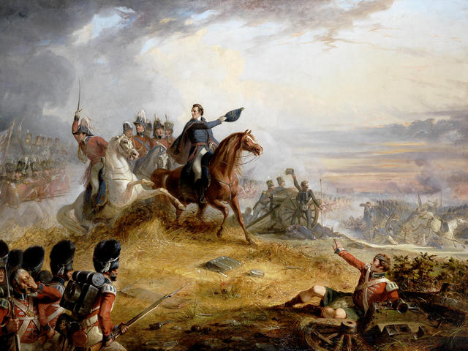
Epic battle scenes

Slide 5
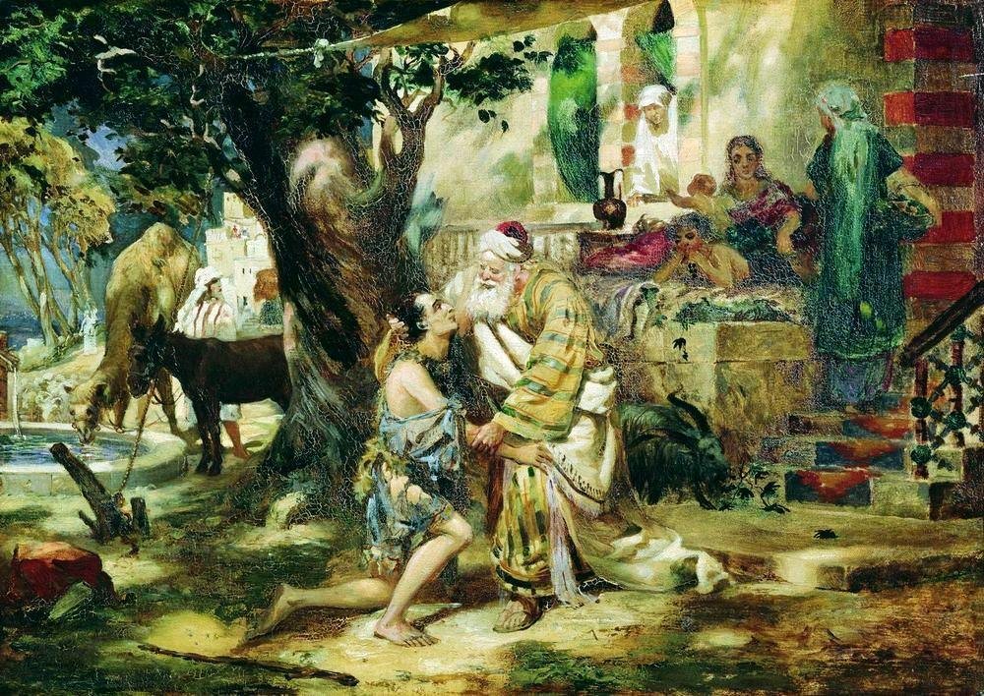
or religious and mythical scenes

Slide 6
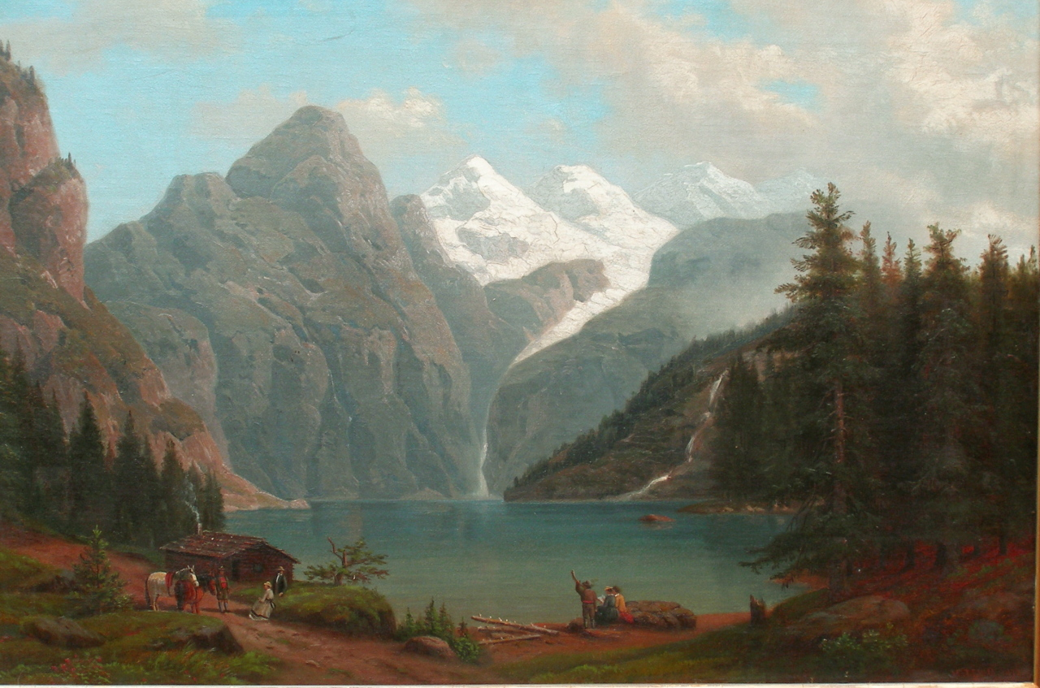
and landscape artists were considered slackers by most critics...

Slide 7
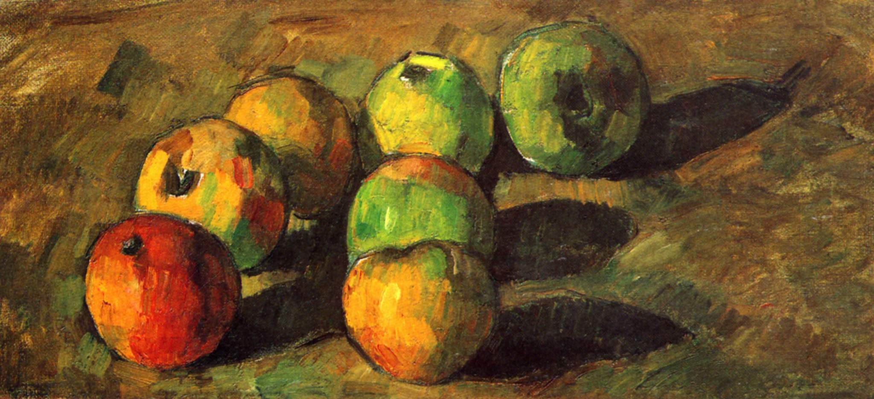
Paul decided to paint only the lowliest art form of them all:
still life!

Slide 8
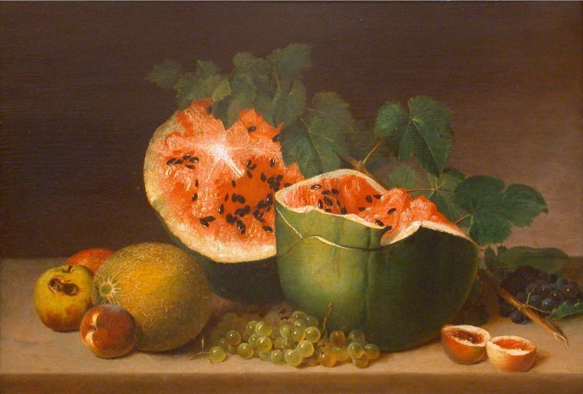
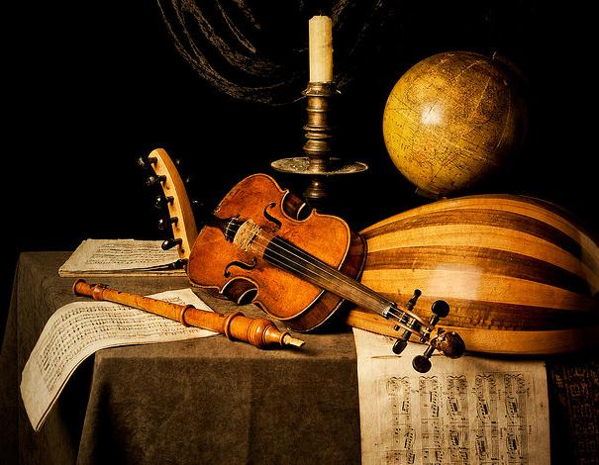
What is a still life painting?
A still life is a work of art capturing mostly inanimate objects.
Often, these are common everyday thing:
Food
Flowers
Plants
Rocks or shells
Drinking glasses
Books
Vases
Jewelry
What else could you paint?

Slide 9
Paul painted still lifes but to prove his point: that art can be anything if you do it right,
he decided to painted the most common thing he could fine:
an APPLE

Slide 10
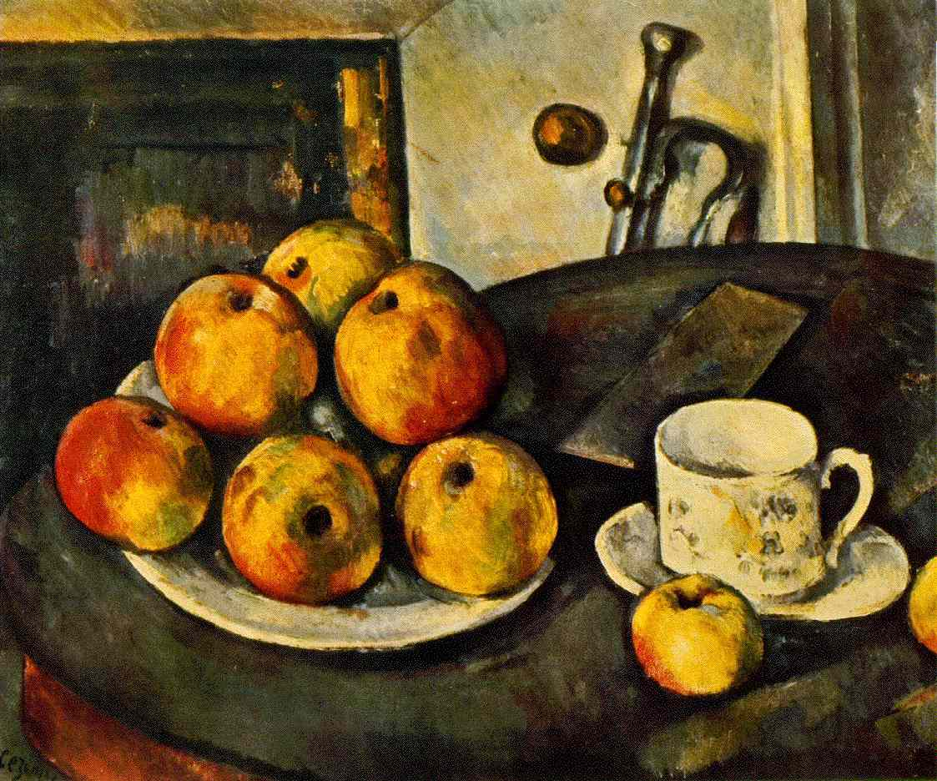
He said: I want to astonish Paris with an apple!
And after more than 30 years of hard work, he did!

Slide 11
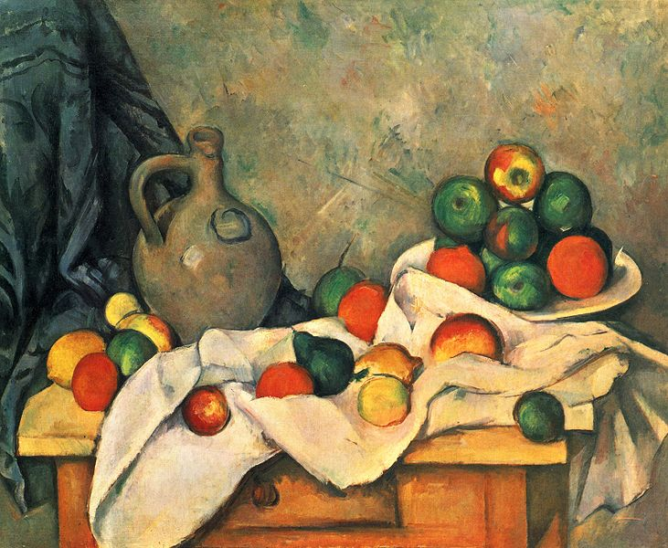
How did he do that?
He focused on the colors, light and space.
He had a lot of fun especially with space… let’s see it!
Still Life, Drapery, Pitcher, and Fruit Bowl, 1893-4

Slide 12
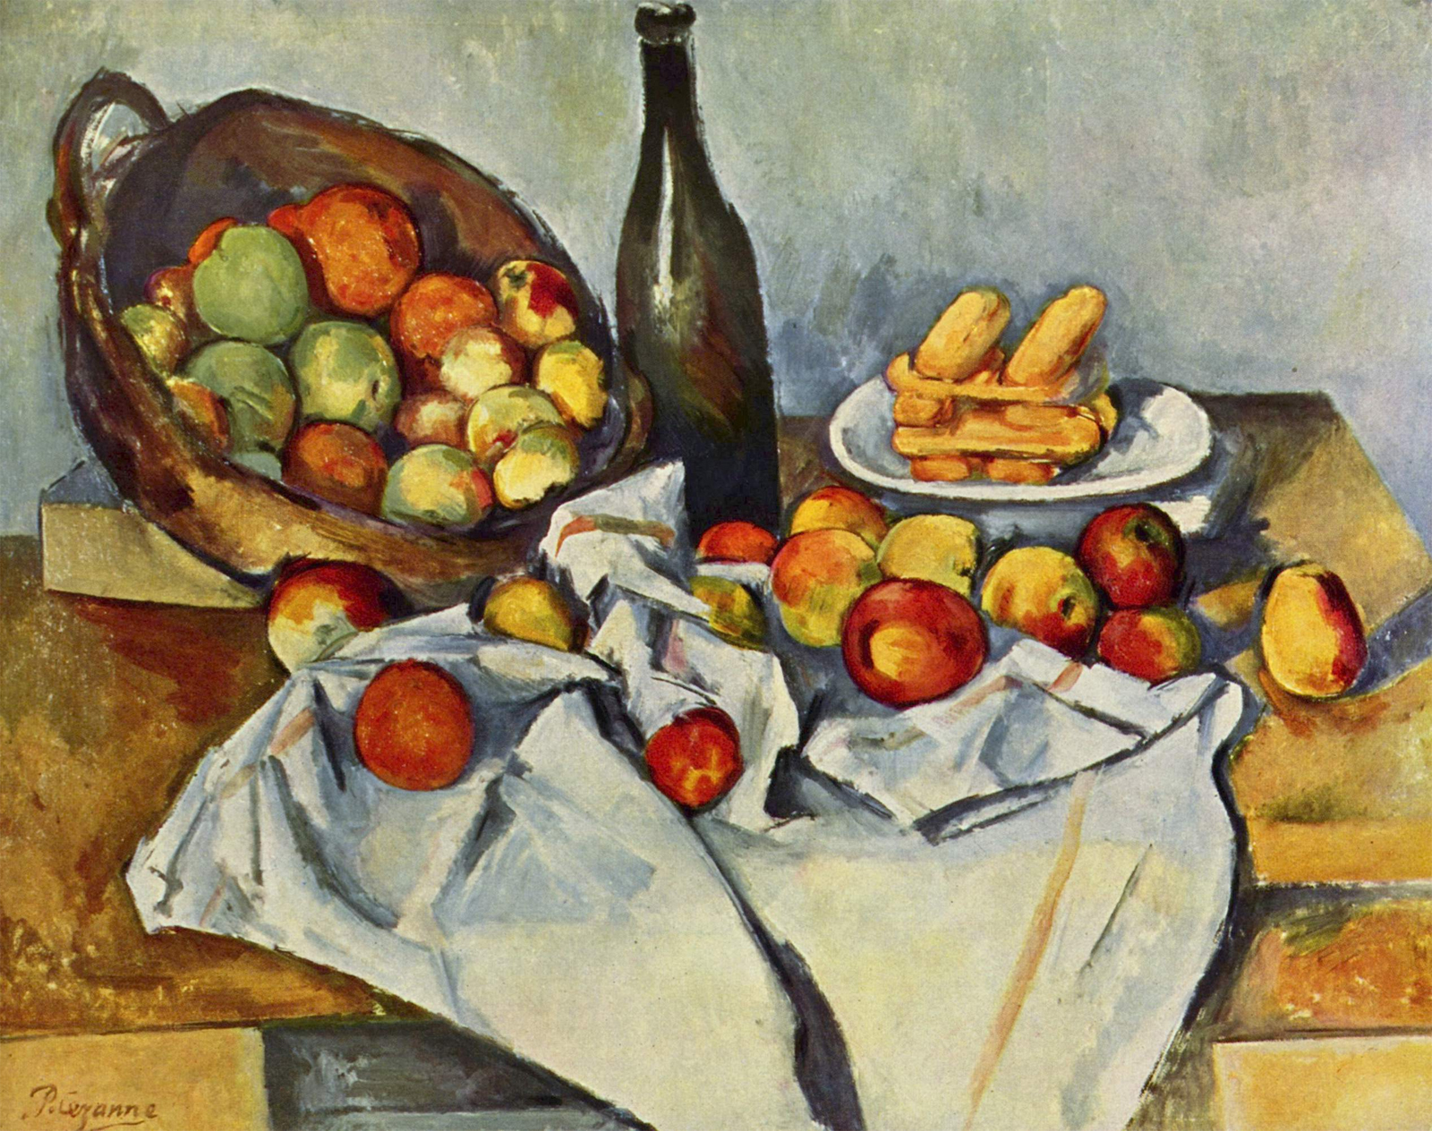
The Basket of Apples, 1890-4
Do you see anything WEIRD, anything that DOES NOT MAKE SENSE in this painting?

Slide 13
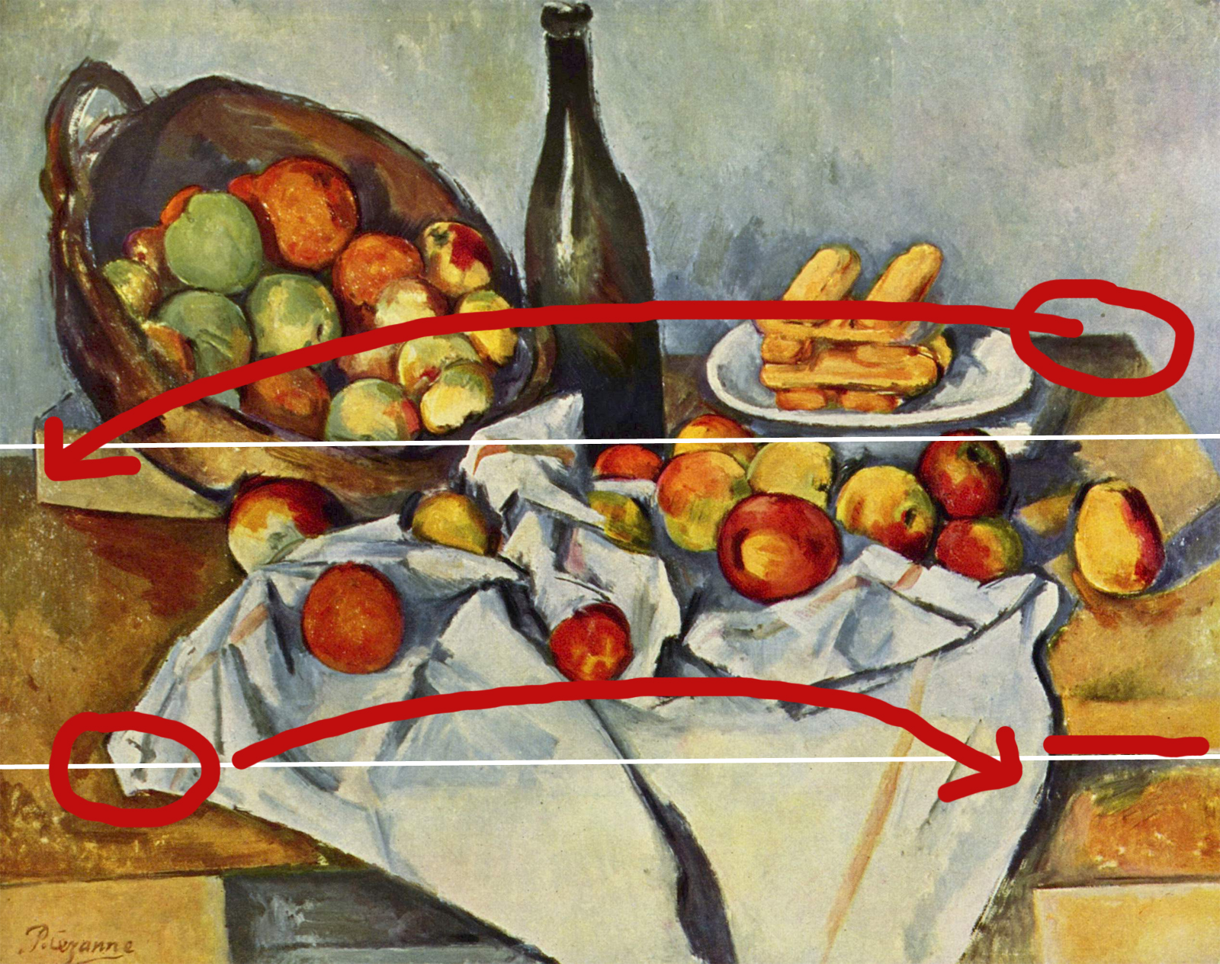
The table ends in different places.
It looks like Paul looked at it from two different places and combined it together.

Slide 14
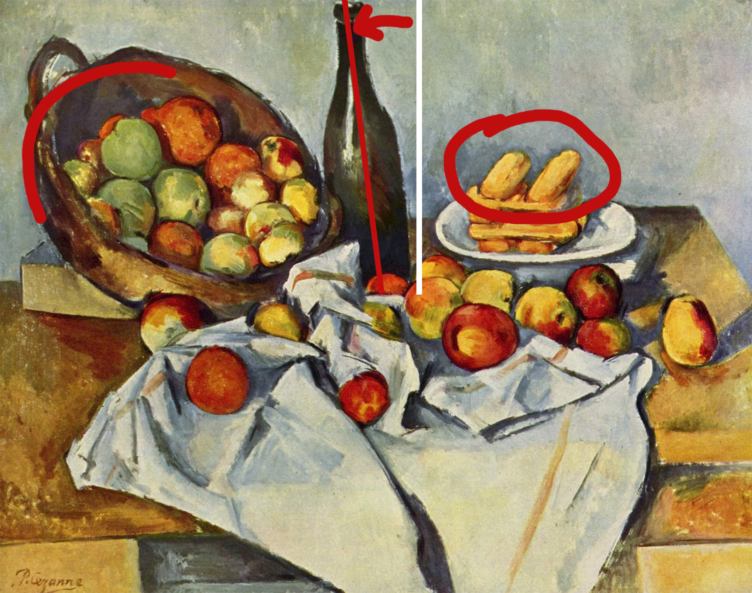
The bottle is tilted. The basket would fall. Biscuits fly!

Slide 15
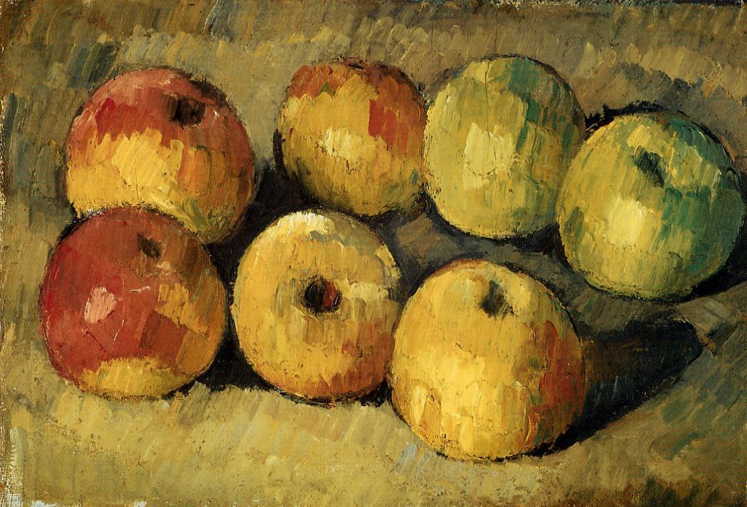
Paul painted over 200 still life paintings with apples.
Apples, 1878

Slide 16
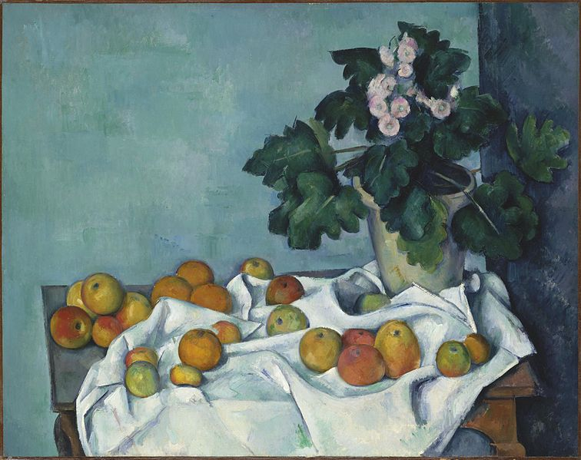
Still Life with Apples
and a Pot of Primroses
1890
He carefully set the scene – with fat coins and small wedges stuck underneath
the apples to tilt them and lift them up.

Slide 17
Still Life, Drapery,
Pitcher, and Fruit Bowl
1893-4
He looked at it from different angles – and used many of them in one artwork.
That is why the paintings trick the eye and keep it moving around, looking for the other edge of the table.

Slide 18
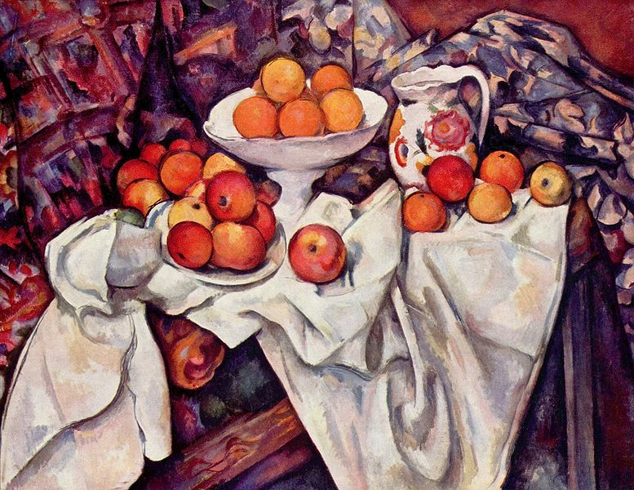
Then he painted the scene. Slowly. For many days.
And yes, often he needed to get new apples.
They got bad – or eaten (if he was hungry).
Apples and Oranges, 1899

Slide 19

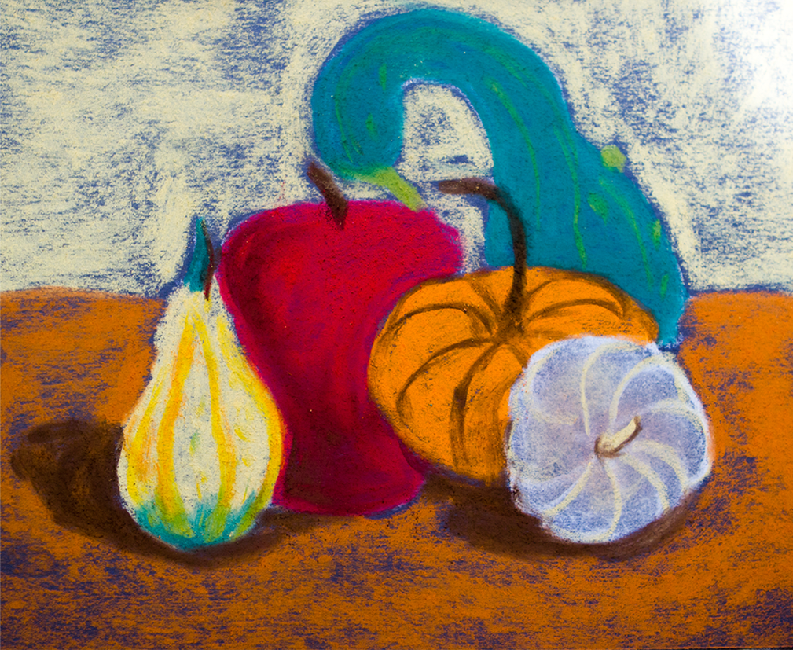
Let’s make some ART!

Slide 20
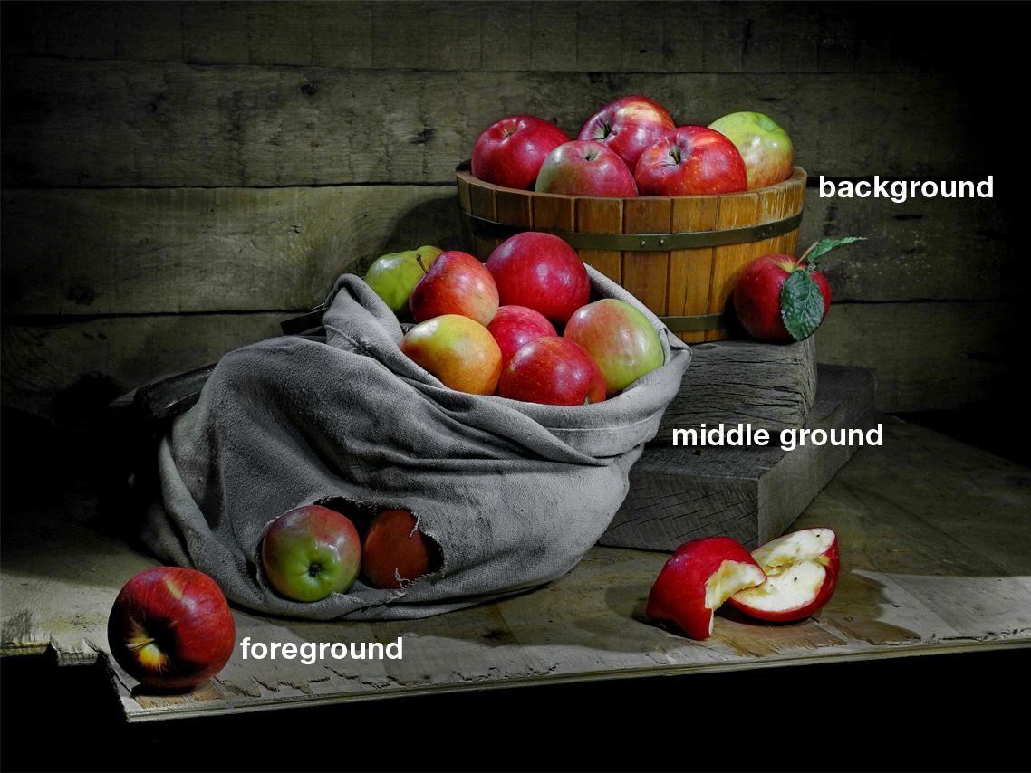
Fist create your still life
What is a composition?
It is the placement of objects in a painting.
It literally means: putting together.

Slide 21
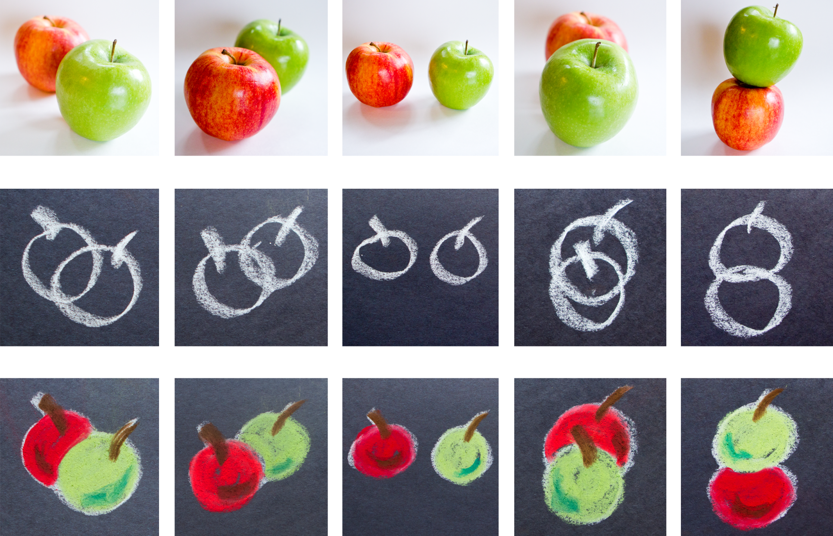
How do you draw this?

Slide 22
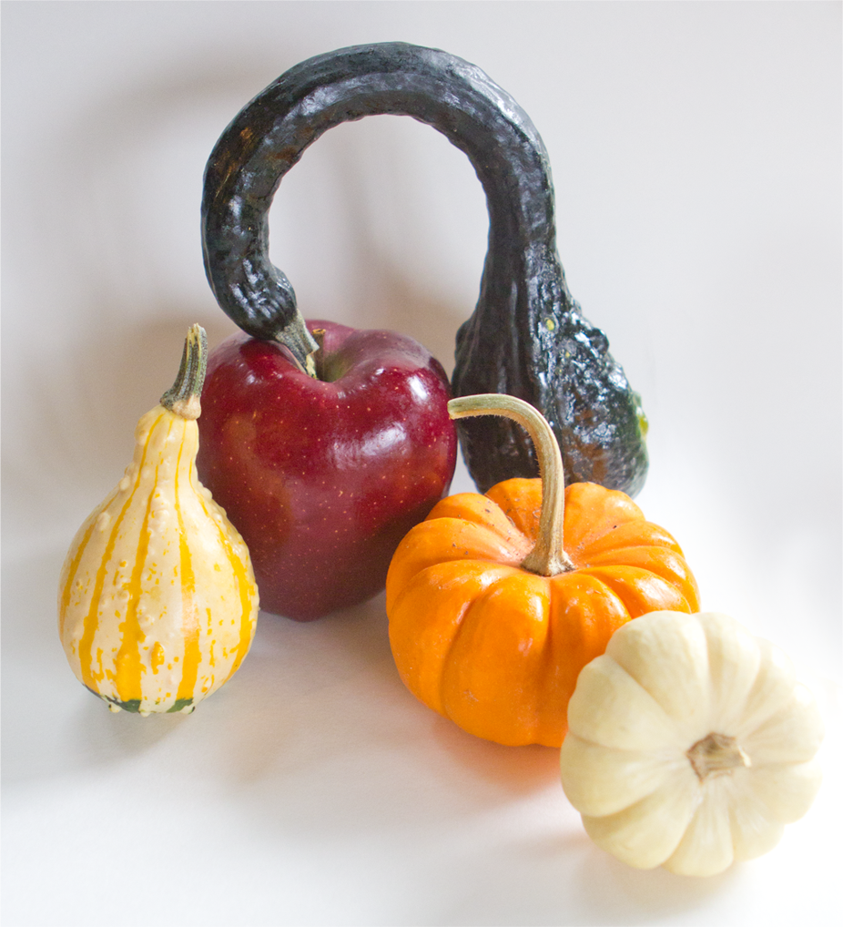
How does your still life look like?
What is in the foreground?
In the middle ground?
In the background?
Do you see any shadows and highlights?

Slide 23
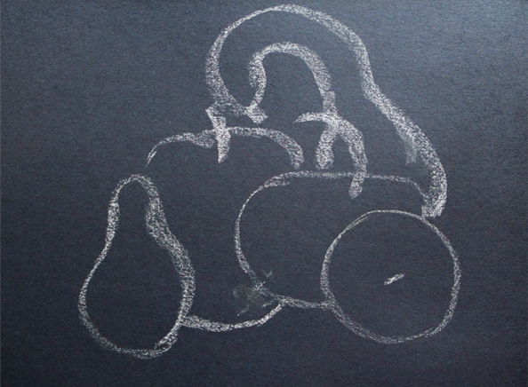
Sketch what you see
But do not be afraid to exaggerate a little, like Paul.

Slide 24

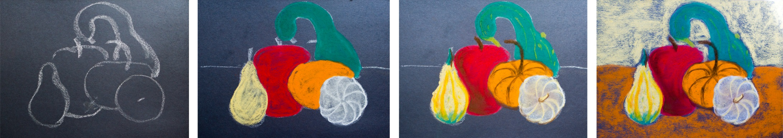

Color it in
Fill in the most basic color first, then add details.
Then add colorful background.
Be careful: do not smudge your work with your sleeves!
When done, use hairspray to ‘glue the chalk to the paper.’

